Slide 1

Course Name
S226 PRT681/PRT585 SOFTWARE ENGINEERING: PRACTICE
​GROUP PRESENTATION SUBMISSION​
Team Name: Sydney Group 2
Members​
Bibek KC(S394325)​
Nikesh Shrestha(S394589)
Simran Chauhan(S393695)​
Susmita Sharma(S394867)

Slide 2
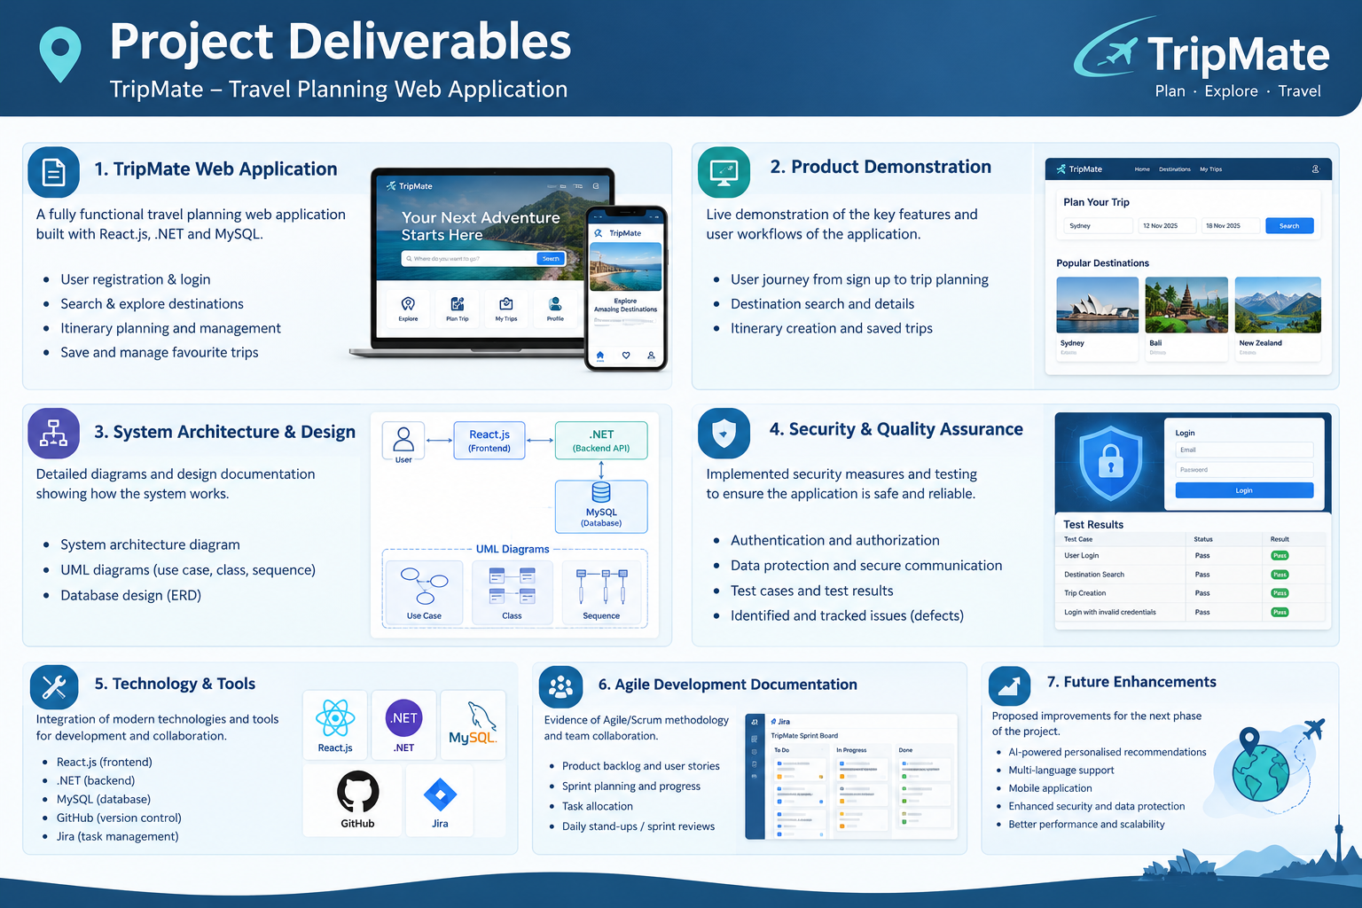

Slide 3
Acknowledgement
Recognising the people and resources that supported TripMate
Teaching Team
Project Team
Tools & Resources
We thank our lecturer and teaching team for their guidance, feedback, and support throughout Software Engineering: Practice.
We acknowledge the collaboration and contributions of Bibek KC, Simran Chauhan, Susmita Sharma, and Nikesh Shrestha.
We acknowledge the development and collaboration tools used in our workflow, including React, .NET, MySQL, GitHub, Jira, and Swagger.

Slide 4

TripMate — Travel Planning Web Application
Module Name
Group
Software Engineering: Practice
SYD Group 2 · 2026
Team Member Name
Bibek Kc · Nikesh Shrestha · Simran Chauhan · Susmita Sharma

Slide 5
Context: The Challenge We Set Out to Solve
Our starting point was a fragmented travel-planning experience and a limited project timeline
•
User Challenge
Team Constraints
Learning Journey
Booking and payments remain future work; we distinguish implemented functionality from planned features.
We had a fixed assessment deadline and needed to coordinate four roles across the full-stack build.
The project brought frontend, backend, database, requirements, and testing work together in one application.
Our response
Focus on a clear core journey first, then identify enhancements for later development.
Scope discipline
Travel details can be spread across search, booking, mapping, and note-taking tools.

Slide 6
Product Overview — TripMate
Why a customer should consider TripMate as a foundation for a more connected trip-planning experience
•
Discover
Plan
Access & Manage
Browse destination ideas and popular destination cards.
Enter destination, travel dates, and guest details to organise a trip search.
Use account authentication and a connected application structure for trip information.
•
Customer value
One consistent interface can reduce the effort of switching between separate planning tools.
Strengths
Clear user journey, separated application layers, API-based communication, and team use of version control.
Scope note
Live booking and payment processing are not implemented in the current scope.

Slide 7
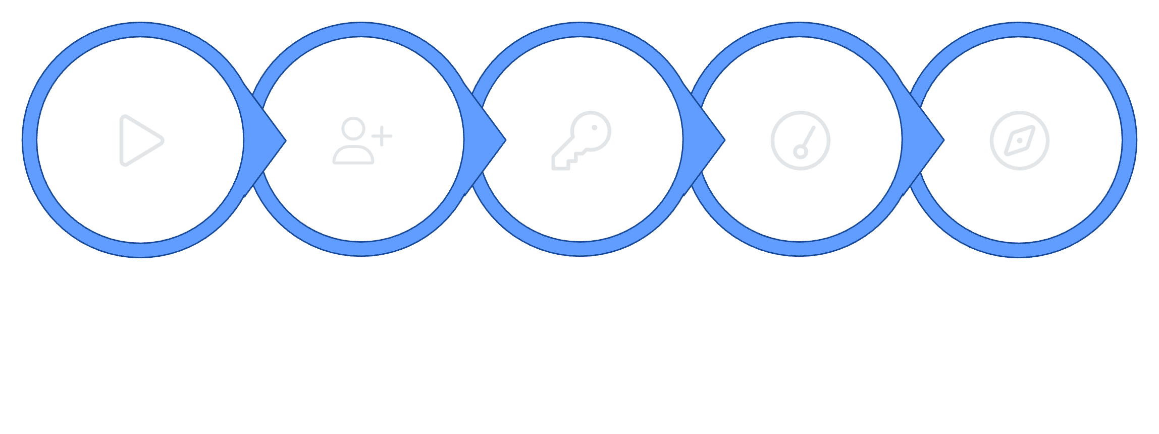
TripMate User Journey
Start
Register / Login
Authenticate (JWT)
Dashboard
Discover
The core journey is structured around authenticated access. Booking functionality is planned and not yet implemented. All intermediate states are subject to verification against current build status.

Slide 8
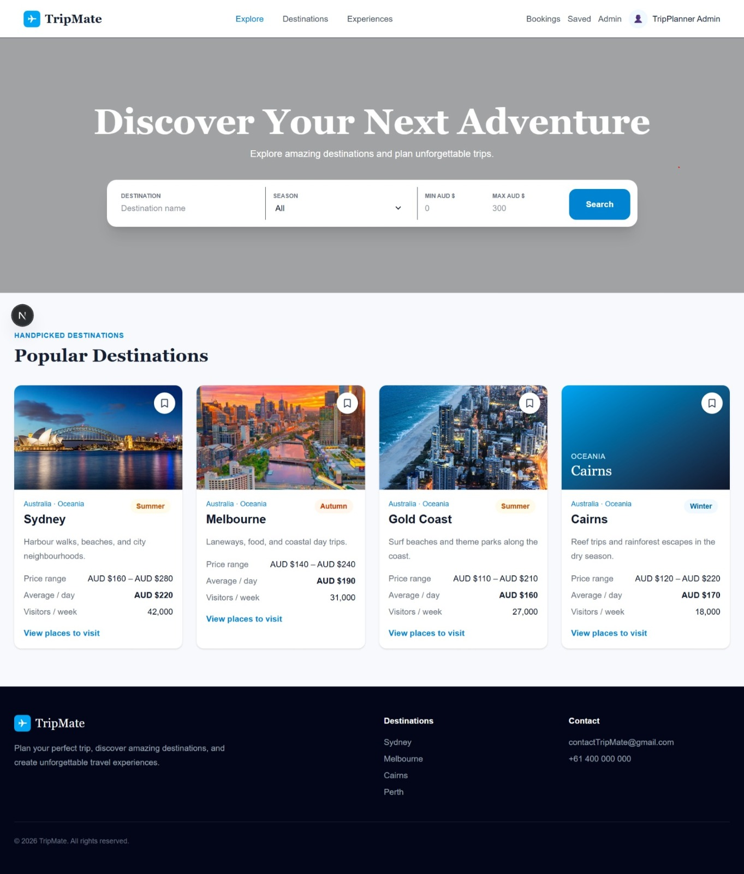
TripMate Frontend Experience
FRONTEND DEVELOPMENT
Actual Homepage Elements
Hero headline: "Discover Your Next Adventure"
Search fields: Destination, Check-in / Check-out, Guests
Primary CTA: Search button
Section: Popular Destinations
Destination cards: Amalfi Coast · Kyoto Gardens · Swiss Alps · Mykonos Breeze

Slide 9
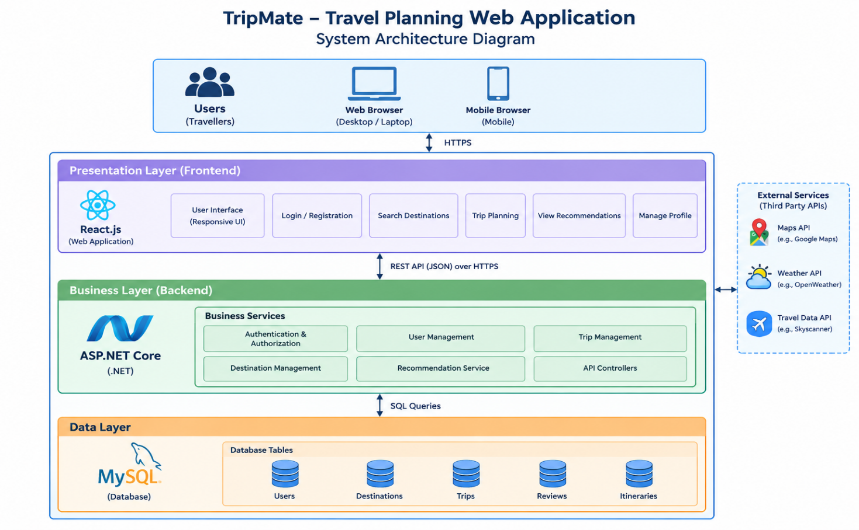
System Architecture
A layered design separates user interaction, application logic, and stored data
Frontend — React.js
Renders the interface and collects user inputs for destination and trip planning.
Backend — .NET 8
Provides API endpoints, application logic, and authentication integration.
Database — MySQL
Stores structured application information; Entity Framework Core supports data access.

Slide 10
Technologies & Development Tools
Each technology supports a distinct part of the product and team workflow
•
React.js
.NET 8 + EF Core
MySQL
Swagger / OpenAPI
Reusable UI components support a consistent and maintainable frontend.
Relational storage for structured application data.
Documents endpoints and supports manual API exploration.
API and business logic are separated from data access.
GitHub
Version history, code sharing, and collaboration across team members.
Jira
Task allocation, progress tracking, and issue management.
Agile/Scrum
Iterative planning, development, testing, review, and improvement.

Slide 11
Security & Risk Mitigation
Security is part of the user journey, not an add-on
•
Authentication
Access Risks
Mitigation Focus
ASP.NET Identity manages user accounts; JWT supports authenticated API access.
Unauthorised access or weak token handling could expose protected user data.
Validate authentication and authorisation, protect secrets, validate inputs, and avoid exposing sensitive errors.
Evidence
Confirm security behaviour against the actual implementation before claiming every mitigation is complete.
Future hardening
Add automated security checks, stronger logging/monitoring, and review dependency updates.

Slide 12
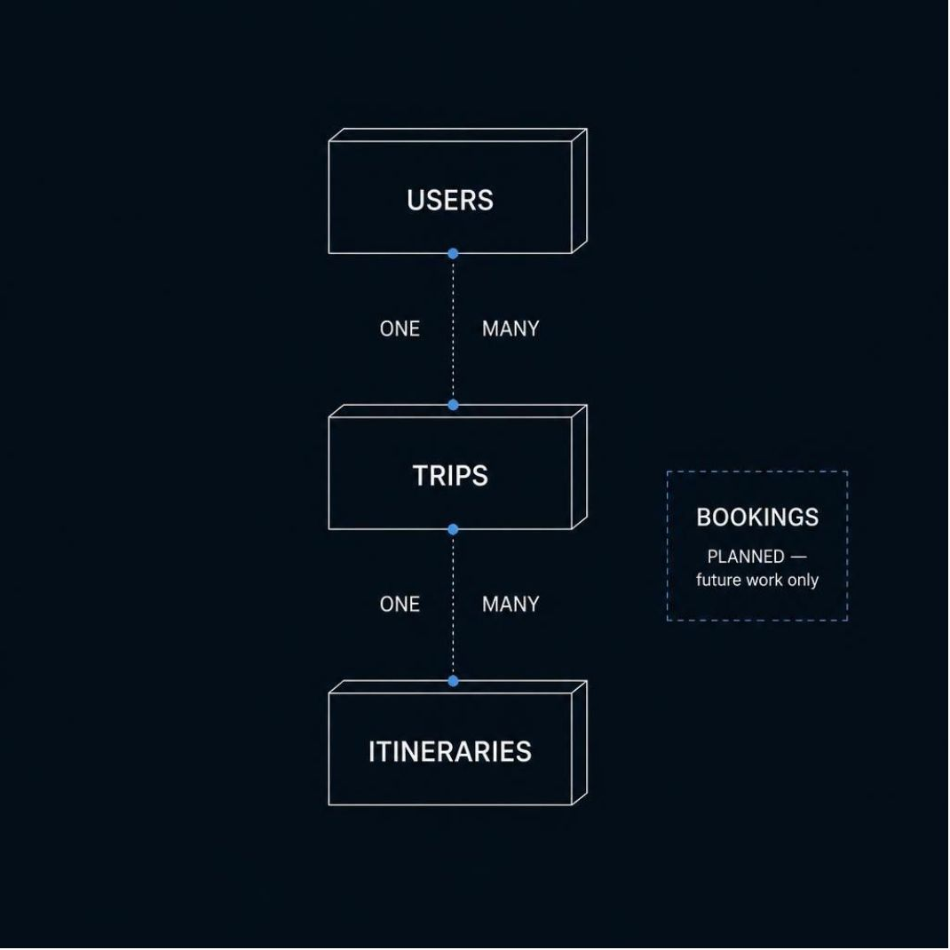
Data Architecture
Conceptual Entity Relationships
Nikesh — Data Workflow
01
Collect
Identify and gather relevant travel data requirements
02
Clean & Organise
Standardise, validate, and structure raw data inputs
03
Analyse
Assess data relationships and quality to inform design
04
Integrate
Map structured data into database and application layers

Slide 13




From Requirements to Quality
BUSINESS ANALYSIS & TESTING — SUSMITA
Requirements Pipeline
Quality Assurance Cycle
User Need
Requirement
Business Requirement
Development
Functional & Non-Functional Spec
Test → Defect Identified?
System Design → Development
Fix → Retest → Validate

Slide 14
Quality Assurance & Maintainability
Quality practices should connect requirements, code changes, and verified behaviour
•
Functional Checks
Integration Checks
Maintainability
Verify key user journeys and form validation against stated requirements.
Check React-to-API communication and API-to-database operations.
Use clear component/service boundaries, consistent naming, and documented API endpoints.
Test cycle
Requirement → test → record result/defect → fix → retest → validate.
Unit testing
Unit tests are an identified improvement area unless the team can show completed test evidence.
Demo evidence
Bring screenshots or a brief test checklist showing pass/fail results from the final build.

Slide 15
Development Process: Agile, GitHub & Jira
The team used a collaborative, iterative approach to coordinate a full-stack project
•
Agile / Scrum
Jira Workflow
GitHub History
Equal Contribution
Plan → prioritise → develop → test → review → improve. Adapt tasks as the build evolves.
Break work into clear tasks, assign owners, track progress, and raise blockers early.
Use small, traceable commits and review changes together.
Split work across frontend, backend, database, and business analysis/testing.
Adaptive teamwork
Share progress, raise blockers early, integrate often, and adjust priorities when constraints or defects appear.
Commit messages
Suggested convention: feat: add trip search; fix: validate login; docs: update README. Check actual history before presenting examples as used.
Task grooming
Clarify acceptance criteria, estimate effort, prioritise core journeys, and allocate tasks by role and availability.
Mythical Man-Month
Late additions can increase onboarding and communication overhead. Small tasks and early integration reduce coordination risk.

Slide 16
Software Demonstration: The Core User Journey
•
1. Open the App
2. Show User Flow
3. Explain the Result
Show the homepage, destination cards, and visible search fields.
Show the response or trip/itinerary state available in the build; explain any incomplete step honestly.
Demonstrate registration/login if working, then enter destination, dates, and guest details.

Slide 17
Limitations & Future Enhancements
Prioritise the core experience, then extend the product in measurable phases
•
Complete Core Planning
Automated Testing
Booking & Deployment
Finish and verify trip creation and itinerary management to make the main planning journey dependable.
Add unit and integration tests to catch regressions earlier and increase confidence in changes.
Consider booking/payment integrations and cloud deployment to make the product more useful and accessible.
•
Performance & security
Profile slow endpoints, validate inputs, review authentication/authorisation, and monitor failures.
Customer value
Each phase should improve reliability, convenience, and trust before expanding the feature set.

Slide 18
Conclusion
TripMate - one platform for planning a trip, built by four roles working as one team
01 Problem Solved
02 Solid Technical Foundation
Travel planning no longer has to be spread across many apps. TripMate brings discovery and itinerary planning into one web application.
A .NET 8 backend with Entity Framework Core, secure ASP.NET Identity and JWT authentication, and a Swagger-documented API.
03 Teamwork That Delivered
04 Clear Road Ahead
Frontend, backend, database and business analysis worked together through Agile/Scrum, using GitHub and Jira.
Next: finish core trip and itinerary features, then add booking, payments, automated testing and cloud deployment.

Slide 19
Thank You
Questions?
TripMate — Travel Planning Web Application
Bibek KC · Simran Chauhan · Susmita Sharma · Nikesh Shrestha
S226 PRT681/PRT585 Software Engineering: Practice · Sydney Group 2
PLAN · EXPLORE · EXPERIENCE

